Slide 1
ECE 530 Cloud Computing
Ioannis Papapanagiotou
CAP Theorem Examples

Slide 2
Book Store: Shop Around the Corner
For example, suppose you run an online book store and you proudly display how many of each book you have in your inventory.
Every time someone is in the process of buying a book, you lock part of the database until they finish so that all visitors around the world will see accurate inventory numbers. That works well if you run The Shop Around the Corner but not if you run Amazon.com

Slide 3
Book Store: Amazonia
Amazon might instead use cached data.
Users would not see the inventory count at this second, but what it was say an hour ago when the last snapshot was taken.
Also, Amazon might violate the “I” in ACID by tolerating a small probability that simultaneous transactions could interfere with each other.
For example, two customers might both believe that they just purchased the last copy of a certain book. The company might risk having to apologize to one of the two customers (and maybe compensate them with a gift card) rather than slowing down their site and irritating myriad other customers.

Slide 4

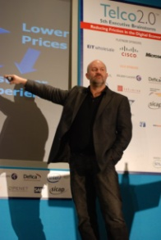
Vogels at the Helm
Werner Vogels is CTO at Amazon.com…
He was involved in building a new shopping cart service
The old one used strong consistency for replicated data
New version was build over a DHT, like Chord, and has weak consistency with eventual convergence
This weakens guarantees… but
Speed matters more than correctness
Notes:
Vogels described the deep technical nature of Amazon's infrastructure work in a paper about Amazon's Dynamo,^{[10]} the storage engine for the Amazon Shopping Cart. He is generally regarded as one of the world's top experts on ultra-scalable systems and he uses his weblog to educate the community about issues such as eventual consistency.^{[11]}

